Slide 1
Flipkart big billion days sales 2024

Slide 2
Agenda
Overview
Data Handling
Data Model
DAX
Visuals and interpretation

Slide 3

Overview

Slide 4
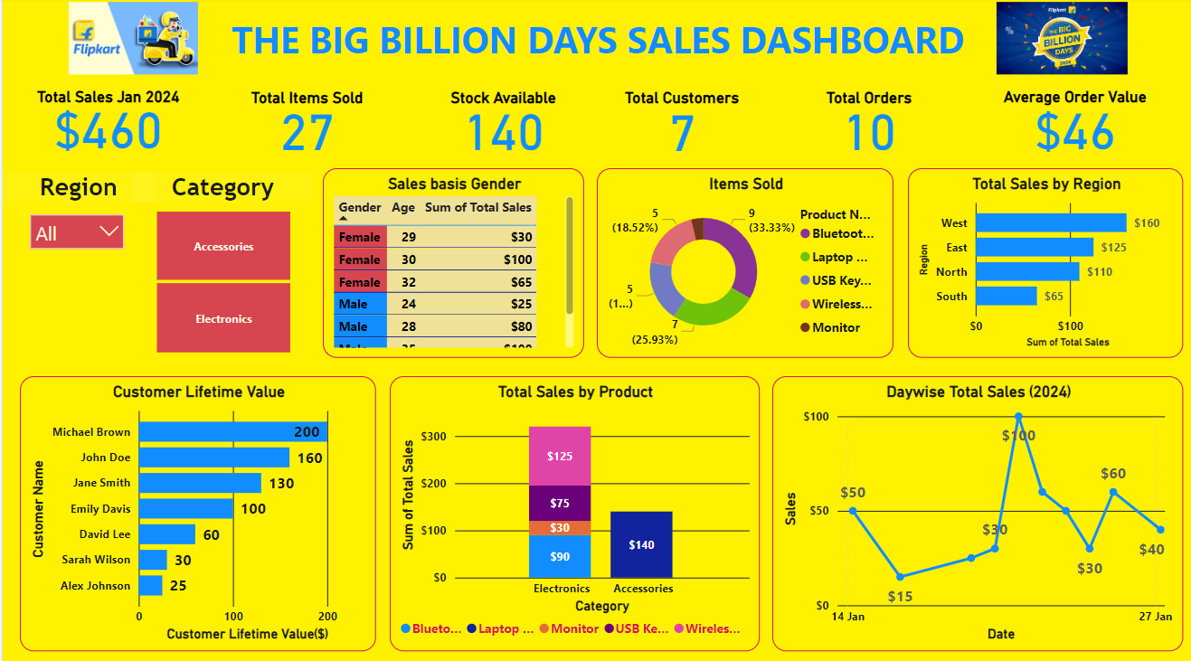

Slide 5
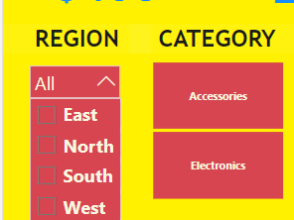
Overview
Total Sales Revenue Jan 2024 - $460
Categories – Electronics, Accessories
Regions – East, West, North, South
Stocks available – 140 items
Slicers
KPI Cards

Slide 6
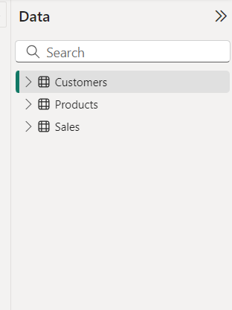
Data Handling
Loading the Data in PowerBI
Data is in .xlsx excel file format.
Three tables are transformed to Power Query.
Data transformed and Day, Month and Year is separated into new columns.
After checking null, error values data loaded into Power BI.

Slide 7
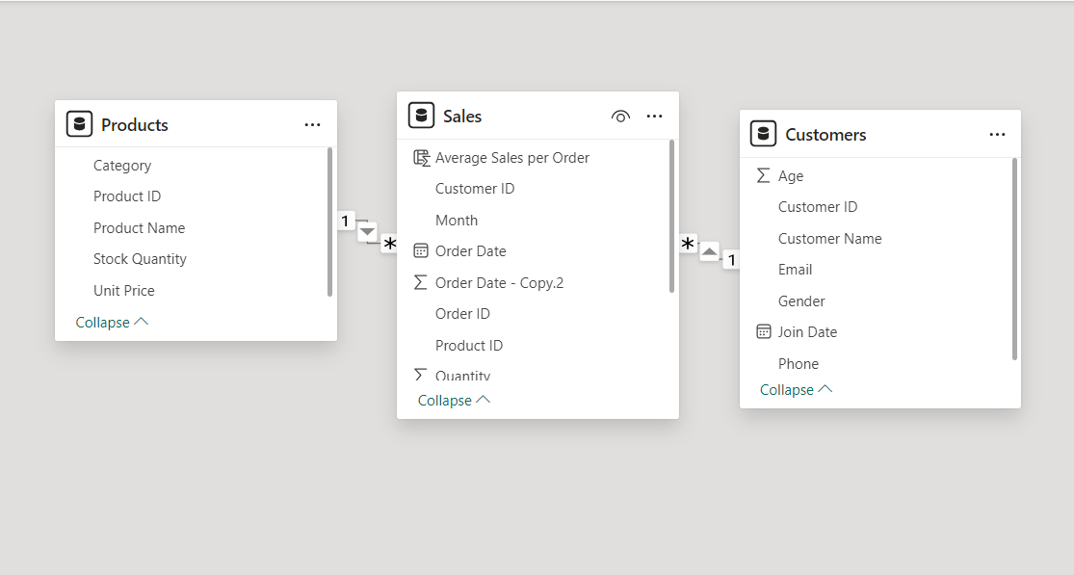
Data model
Tables ar
Relation between Products, Sales, Customers table was created.

Slide 8
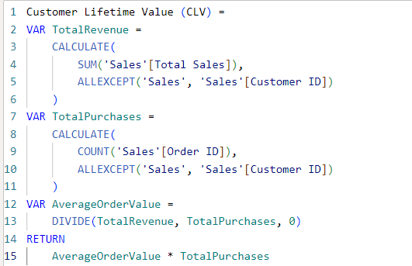
DAX (Data Analysis Expressions)
In Power Query Merged Day and month columns.
Customer Life time Value (CLV)
New column added and new measure was created to find CLV.
It is a metric used by businesses to estimate the total revenue a customer will generate for a company over the entire duration of their relationship. CLV helps businesses understand the long-term value of a customer, which can inform decisions around marketing, customer retention, and product development.

Slide 9
Visuals and interpretation
Sales Performance Dashboard for Flipkart During Big Billion Days

Slide 10
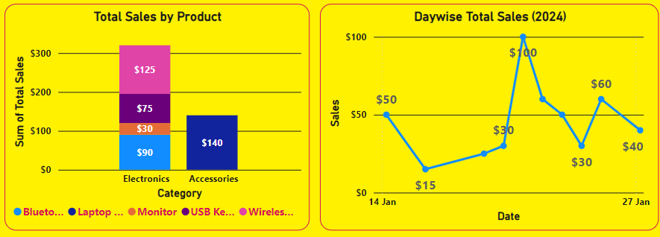
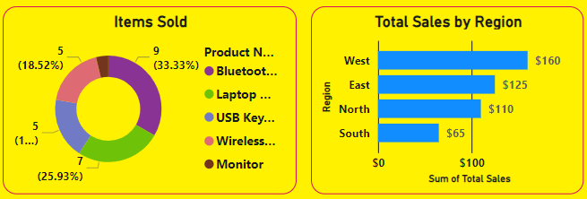
VISUALS
Highest Sales by Category – Electronics
Highest revenue per day - $100 on Jan 22 nd
Among items Bluetooth was sold in in numbers.
Laptop stand is the highest contributor in the total revenue - $140
Top revenue earned region is West.
Sales chart
Pie chart, bar chart

Slide 11
Interpretation
REGIONAL REVENUE
WEST- $160
EAST - $125
NORTH - $110
SOUTH - $65
Male Customers are higher than Female customers
It is notable that in middle of the sales days highest revenue is seen.
Accessories items: Laptop Stand
Electronics items: Bluetooth speaker, Monitor, USB Keyboard, Wireless mouse.
Highest CLV customer is from East region.

Slide 12
THANK YOU
Revathi D
revathidu@gmail.com

